Slide 1
Public & policy engagement for researchers
Emily Jesper-Mir
Ilaina Khairulzaman
Notes:
Good morning. Welcome to this workshop on policy engagement for researchers, brought to you by Sense about Science. I’m Ilaina Khairulzaman and I’m the head of international public engagement, training and marketing. The first thing I’m going to do is introduce a bit of what I do, and get my colleagues Hamid, Emily and Rebecca to introduce them, and get all of you to introduce yourselves too. It would be wonderful if you could talk about any policy experience you have, that we can discuss a bit more at the end of this workshop. Is that okay?
It is great to meet all of you and so good to know you’re striving to understand the importance of researchers getting involved in policy discussions.
I want you to know that you are exactly what the world needs. Because society needs people like you to clearly communicate your evidence so that policymakers can work from the best possible information.
As a society we need complex information to be made accessible to policymakers, which means we need clear and timely communication of evidence to policy. So who are Sense about Science and how do we contribute to this debate?
Sense about Science is an independent campaigning charity that champions the public interest in sound science and ensures evidence is recognised in public life and policy making. We challenge the misrepresentation of science and evidence in public life, and we advocate openness and honesty about research findings. We’ve worked with community groups, civil society organisations, journalists, policymakers and researchers for 18 years to stand up for sound research and for evidence as a public good.
And I’ll now hand over to Ilaina, who will tell you more about us.

Slide 2



Mobiles phones cancer inquiry
Evening Standard, 17th Jan 2003
New evidence ‘shows MMR link to autism’
Daily Mail, 9th Aug 2002
Trials of GM crops bring new fears
of 'Frankenstein' food
Daily Mail, 30th Dec 2002
Notes:
This the climate that SaS was born into; it was a baptism of fire 18 years ago.
Claims that MMR caused autism, the BSE crisis & “frankenfoods”, the term used to describe GM crops.
In all these debates, evidence was being misrepresented or neglected, and in some cases it was missing altogether.
Worst of all, few scientists were speaking out. They didn’t feel supported and there was no safety in numbers, so one of our first steps was to launch our Voice of Young Science programme to empower early career researchers not to wait until they have a professorship before they start standing up for science. We run workshops around the UK and Europe to equip early career researchers with the confidence and skills to get involved in public discussions about research and evidence, including engaging with policy debates. During this session, you’ll see some practical tips that have come out of these workshops and there will also be a chance to have a go at one of the interactive activities from the workshop that will get you thinking about the true scope of your expertise.
Now, 16 years on, amid the Covid-19 pandemic when the quality of research evidence used in policymaking has such an immediate, visible and powerful impact on society, there is an incredible call for the contribution of researchers. By getting your voices heard, whether you’re early career or senior, you can help your communities and wider society to make sense of crucial evidence when it really matters in their lives. Understanding how and where to take evidence to policy is a highly effective way to play your part.

Slide 3
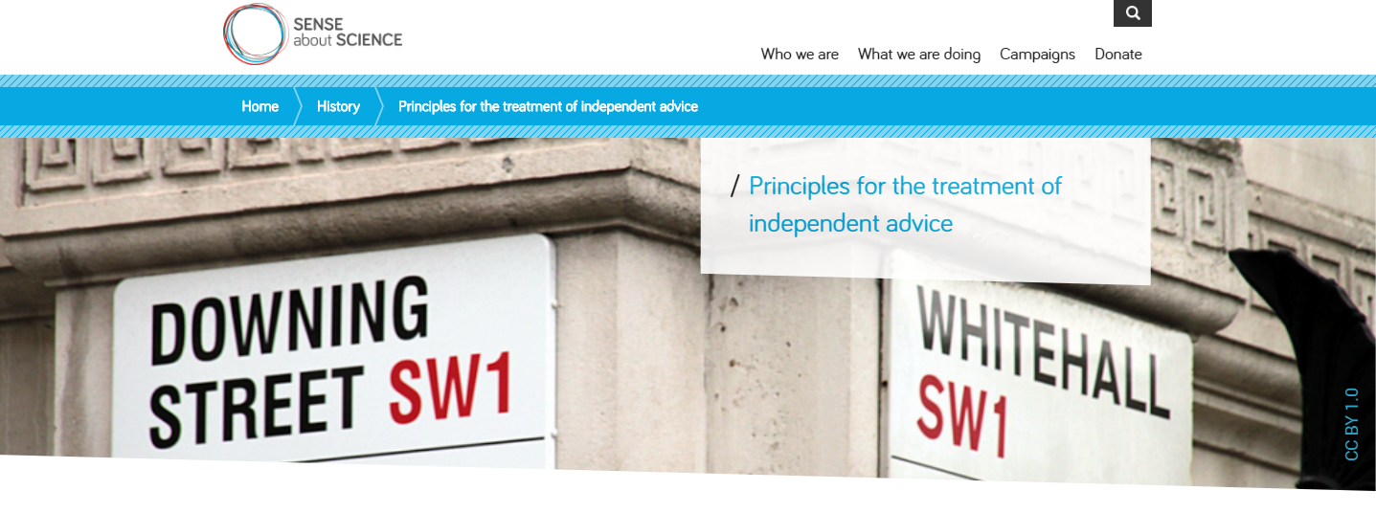
Notes:
How have we done that at Sense about Science? How have we shaped and led the policy debate in the UK and around the world?
Principles of Science Advice:
In 2009 the sacking of Professor David Nutt from the Advisory Council on the Misuse of Drugs (ACMD) raised significant concerns in the scientific community about independence of Government advisors. Sense about Science helped lead a campaign to set out explicitly the principles underlying independent advice and seek Government’s confirmation of them — to reaffirm all that is good about the independent advisory system, to ensure that new ministers understood what its benefits were, and to reduce the likelihood of public cynicism about scientific advice to Government.
Sense about Science drafted principles for the treatment of independent scientific advice, backed by effort and pressure from nearly 100 advisers. The Government adopted the 'Principles of scientific advice to government’ into the Ministerial Code in April 2010. That advice is key today, still has policy implications. Independent advisors were protected.

Slide 4

Notes:
Libel reform:
[you can involve public in what sounds like an esoteric issue but actually we mobilised the public, which was necessary for the change]
Sense about Science launched the Keep Libel Laws out of Science campaign in June 2009, calling for reform of the UK’s libel laws to protect open scientific discussion. For a long time, England & Wales’s libel laws had been considered a “soft touch”.
Our interest in this started when a doctor called Peter Wilmshurst published findings linking a migraine drug to increased incidence of a particular cardiac condition, and accused the manufacturer of underhand practices.
Although the findings were published in an American cardiology journal, the makers of the drug lodged a series of libel suits against Wilmshurst personally in England, starting in 2007.
Dr Wilmshurst refused to back down, but the case only ended when the company went bust in 2015.
In 2013, we celebrated success as our campaign involving small organisations, thousands of individuals and good parliamentarians achieved changes that were denied to citizens and publishers for a century.
Restrictions on trivial claims, a stronger defence of fair comment, and a new public interest defence were incorporated into the Coalition government’s Defamation Act 2013.
But as founding members of the Libel Reform Campaign, our involvement continues as we seek extending the Act’s provisions to Scotland and Northern Ireland.

Slide 5

Notes:
AllTrials:
Clinical trials are the best way we have of testing whether a medicine is safe and effective. They can involve thousands of people, patients and healthy volunteers, and take years to complete. But as of 2013, results from around half of all clinical trials remained hidden. Millions of volunteers participate in clinical trials in good faith to help find out more about the effects of treatments on disease, yet that important ethical principle about reporting has been widely ignored. Information on what was done and what was found in these trials could be lost forever to doctors and researchers, leading to bad treatment decisions, missed opportunities for good medicine, and trials being repeated. This is what led us to launch the AllTrials campaign in January 2013, a campaign which is now supported by thousands of individual patients, clinicians and researchers across the world, and by hundreds of organisations representing millions of people. We aim to achieve a situation globally where all trials are registered and results reported.
Our campaign secured a major win in June 2014, when the new EU Clinical Trials Regulation came into force, containing a law that says clinical trials in the EU must be registered and reported. In 2018, the Commons SciTech committee used evidence submitted by the AllTrials campaign to produce its report on research integrity: Clinical Trials Transparency. Working with them, we succeeded in increasing the overall reporting rate for UK university and NHS Trust-sponsored trials on the EU Clinical Trials Register from 48% to 64% by securing a commitment that university vice-chancellors who did not act to increase transparency would be called to answer in front of the committee. We continue to fight to get complete reporting transparency.
Separation between MEPs and citizens. Citizens noting their concern had an effect. It was unusual for them to get this direct contact. No pop into constituency office, so when citizen make their voices heard it has effect. Big policy changes can be made.

Slide 6
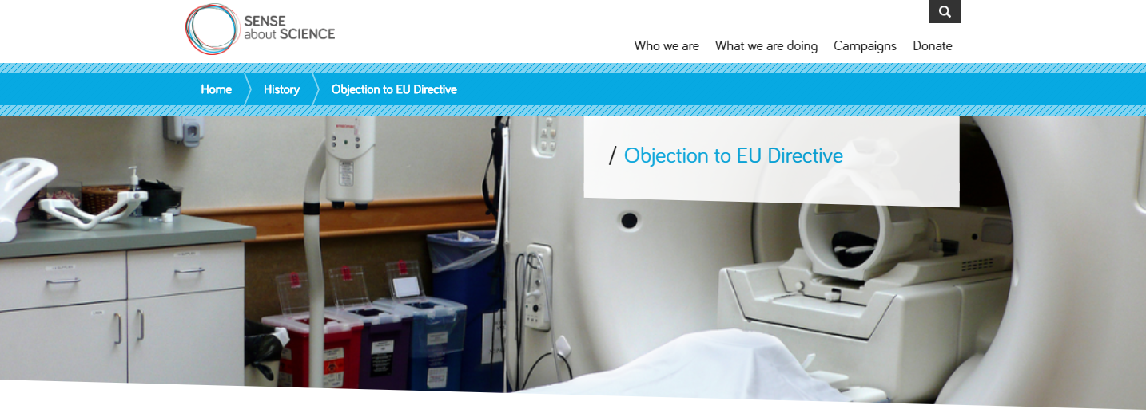
Notes:
In 2004, Sense about Science led a group of scientists and researchers in highlighting and objecting to an EU Directive that sought to set limits on occupational exposure to electromagnetic fields. The directive would have made many procedures using magnetic resonance imaging (MRI) illegal.
Sense about Science, the Royal College of Radiologists, the Institute of Physics, the British Institute of Radiologists and the Institute of Physics and Engineering in Medicine, campaigned with scientists to repeal the directive. We ran briefing sessions in Parliament, gave evidence to government enquiries and the Commons Science and Technology Committee and raised awareness of the issue in the media. In October 2007 the implementation of the directive was delayed for four years, pending further research, and then finally repealed in 2013.

Slide 7
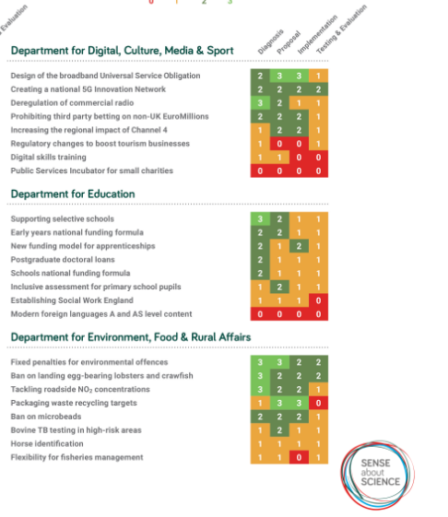
Can someone outside government work out what the government is proposing to do and why?
Analysed policies from past 12 months from 13 departments
Policy: an intervention aiming to change the status quo
Policy documents: First time the policy was put before the public with some detail
Our report highlighted good and bad practice
Collaboration with departments (directors of analysis), before and after research and publication
senseaboutscience.org/activities/transparency-evidence/
Notes:
Aside from these campaigns that focus on specific issues, we are involved in a broader fight for a culture change in the way policymakers use evidence. That prompted us to conduct the first ever transparency review of government policies. Key question: has the govt explained what they’re going to do and why? And what was our method for investigating this? Transparency of evidence, chain of reasoning point is crucial. We produced a framework that used a traffic light system to rank different departments based on the clarity of their chain of reasoning for a selection of their policies. Researchers scored a sample of policies against the evidence transparency framework, asking ‘Can we tell what evidence has been used? Can we tell how the government has assessed or used this evidence?’ under each of the following headings:
Diagnosis (the issue the policy is designed to address)
Proposal (the government’s chosen intervention)
Implementation (how the intervention will be introduced and run)
Testing and evaluation (plans to assess whether the policy has worked)
This report highlighted good and bad practice and demonstrated what departments needed to do to improve their performance.
Why does it matter? Because people need to see government’s reasoning to understand what the government is trying to do and whether they think it will work. Without transparency, the public cannot understand or question proposals. And you as researchers can’t evaluate the evidence the government is using, improve on it or work out where the gaps are that you can contribute to.
Sense about Science again succeeded in securing a major policy win when the Treasury adopted the evidence transparency framework into its policy making guidelines, known as the Green Book, in 2018.

Slide 8
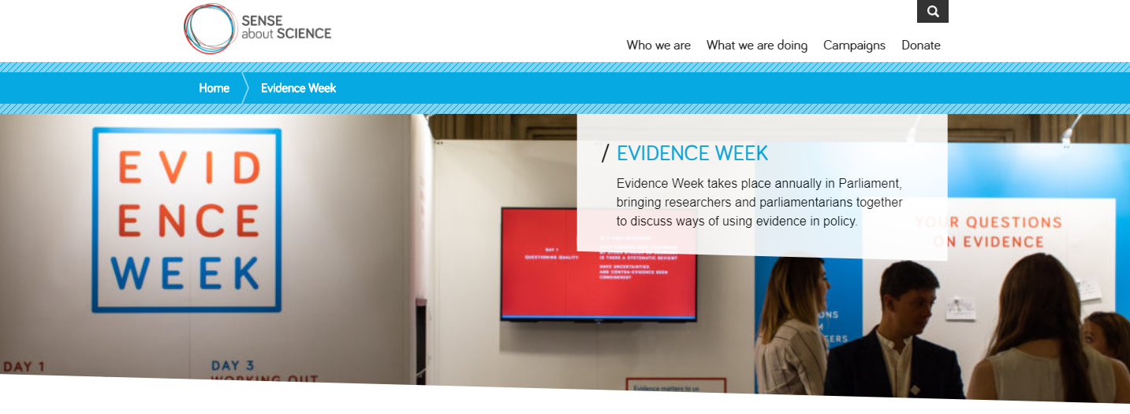
Notes:
Evidence Week:
Evidence Week is held annually in UK Parliament, and brings together researchers, community groups and parliamentarians to share ideas about research and policy. Evidence Week helps researchers think through what the policymaker needs. Focus should be on 3 minute pitch – we coach them in their communications – making sure the policy implications are clear in 3 minutes,
Parliament is where the issues that affect us are raised, debated and reasoned through. MPs move from discussing the impact of housing policies in their constituencies to debating extended cancer screening programmes; from interrogating the assumptions behind the user-demand models for HS2 to questioning the Treasury on which regions will benefit from a new innovation fund.
It’s a tall analytical order for people whose primary job is to represent their constituencies and parties, but we believe that MPs don’t need a scientific background to understand evidence. Evidence Week is an opportunity for the public, parliamentarians, and researchers to come together to share knowledge and insights that will help politicians scrutinise evidence.
The inaugural event in 2018 and the second one in 2019 were the highest-attended events in Parliament by MPs in both years.

Slide 9
Introduction to Policy
Notes:
I’m now going to hand back to Ilaina who will talk about why it’s so important for you to get involved in taking evidence to policy discussions and some of the routes you can use to access policymakers

Slide 10
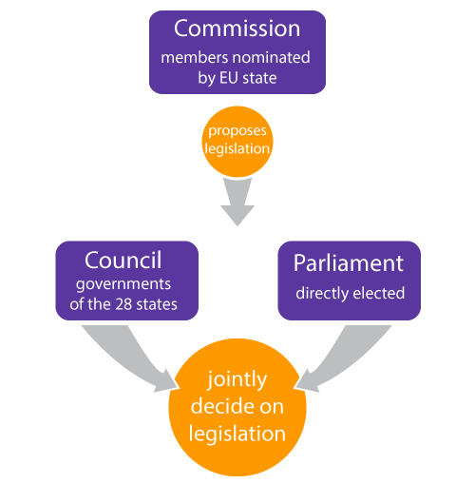
What is policy?
A policy is ‘a plan, course of action, or set of regulations adopted by government, businesses, or other institutions designed to influence and determine decisions or procedures’ (UK Department for International Development, 2005).
The European Commission, the European Parliament and the Council of the European Union are the three central legislative institutions of the European Union.
(University of Portsmouth, European Studies Hub, 2013)
Notes:
'Policy maker' is a broad terms that covers all the people responsible for formulating or amending policy. In national parliaments this could include ministers, members of parliament, advisory staff, chief scientific advisors. In the European Parliament it’s similar, except it includes members of the European parliament, Commissioners and members of the European council.
A key thing to remember about these three institutions is that they represent different interests in the EU bureaucracy.
Put simply:
The European Commission represents the interests of the EU as a whole.
The European Parliament represents the interests of European Citizens.
The Council of the European Union (often referred to as just the Council or the Council of Ministers) represents the member state governments.
Policy makers tend to be approached by a large number of people hoping to influence their policies, from lobbyists and interest groups, to constituents or academics. They are often time-poor, and tend to be generalists, but it is important not to underestimate their skills and experience, particularly when it comes to understanding complex issues and assimilating knowledge.

Slide 11
How does the policy making process work?
Rationale
Evaluation
Feedback
Objectives
Appraisal
Monitoring
Notes:
The policy process is often represented as a cycle. For example, the Treasury's Green Book uses the following stages to understand the policy making cycle:
Rationale - a rationale is developed
Objectives - objectives are set
Appraisal - options are appraised
Monitoring - effects are monitored
Evaluation - results are evaluated
Feedback - evaluation results are fed back into the cycle
However, the Institute for Government suggests that policy making in the real world tends to operate on a less rational, more opportunistic basis.
Policy doesn't tend to take place in distinct stages as suggested above.
Policy makers are influenced by a range of different factors that are not captured in this simple cycle, including budget restrictions, public opinion, political parties, values and ideology, mass media, interest groups, events, social and economic conditions, and even...research.
The effects of policies are often indirect, diffuse, and take time to appear. Given the complexity of the problems government deals with, it may be unlikely that a policy will produce effects that are measurable and attributable.
So, although it is simplistic to suggest that there are natural 'stages' at which researchers can input evidence into the policy making process, there are some natural entry points, and some useful tips and techniques when working with policy makers.

Slide 12
Research and evidence in policy making: why should you get involved?
Responsibility beyond doing research
Informing decision-making
Career development
Notes:
Your responsibility as a researcher goes beyond doing the research – you can make societal impact from the very start of your research through the lifetime of your career. As experts who understand complex issues, you CAN channel that expertise into making a difference in society – from getting involved in public discussions about research and evidence, to providing evidence to policies that impact people’s every day lives. We aim to create a generation of researchers who are motivated, inspired and empowered as academic citizens to shape the public discourse in their field and make a wider societal impact by effectively and confidently getting their voices heard in the media and policy worlds. We want researchers to feel like you have the support of a huge community of your peers in challenging misrepresentations of science and evidence, engaging directly with the media and policymakers, and helping communities to access and understand evidence when it really matters in people's lives. Because this can have a truly transformative effect on people’s live. An example: CHRISTINA PAGEL

Slide 13
The routes in – how policymakers get evidence
Correspondence with individual MEPs
Committee hearings
MEP Initiatives
European Commission proposals
Public consultations
Intergroups
European Parliamentary Research Service
Third party – charity, think tank, evidence broker
Notes:
The routes into EU parliament
Contact individual MEPs – you can find out who your MEP is on the European Parliament website. They’re always happy to talk to constituents. But before you do this – do some research on them. What do they have on their agenda already? It’s always easier contributing to something the policymaker is already interested/involved in than it is to bring something completely new to the table. Policymakers already have a lot on their plate – so think about how you can make their lives easier!
Committee hearings - A lot of the work that is done by the European Parliament is organized in thematic committees. These are cross-party groups of Members (MEPs) that scrutinize legislative proposals from the European Commission. Most committees organize regular hearings, to hear from experts and hold discussions on the key issues. Parliament’s administrative services, political groups or individual MEPs can suggest experts. This is why it’s great to develop a connection with individual MEPs too – so you could get on their experts list.
MEP initiatives - When an individual Member wants to put a topic on the policy agenda or stimulate an in-depth discussion, they can organize an event, which is open to the public. In these events generally one or more experts have the chance to explain the available scientific evidence in more detail.
Another tool often used by MEPs when confronted with new evidence, are parliamentary questions. These are questions MEPs address to other EU Institutions and bodies. They are a direct form of parliamentary scrutiny.
European Commission proposals - The European Commission is responsible for planning, preparing and proposing new European legislation. This is called the ‘right of initiative’. Most of the evidence used for investigating a societal problem and for comparing different policy solutions, will be gathered by the European Commission. An important way to gather such information is through public consultations. The ‘Have your say’ website can help you stay up to date with these.
Public consultations - Through public consultations you can express your views on the scope, priorities and added value of EU action for new initiatives, or evaluations of existing policies and laws. It’s so important that researchers contribute to these public consultations or else there’s the risk that the input they get is only from industry groups or lobby groups.
Intergroups - Intergroups can be formed by MEPs from any political group and any committee, with a view to holding informal exchanges on particular subjects and promoting contact between Members and civil society. They exist on a wide variety of areas, from children’s rights to ‘Sky and Space’. Intergroups are generally supported and organized by an NGO or advocacy group. Intergroups meet to discuss, campaign on and promote particular issues.
A register of Intergroups is regularly updated. Some, but not all Intergroups have their own website.
These are just some ways that research gets to policymakers – but there’s also the European Parliamentary Research Service which you can contact, or going via third party routes such as a charity, think tank, or evidence broker

Slide 14
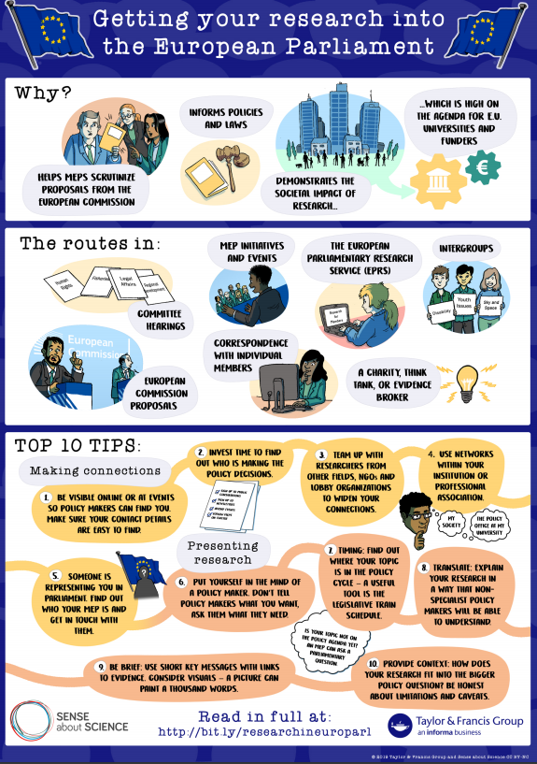
To sum it up in a graphic…
  Collaboration with Taylor & Francis to create a guide for researchers to engage with EU policymaking.
https://authorservices.taylorandfrancis.com/getting-your-research-into-european-parliament/
Notes:
We collaborated with Taylor & Francis to create this guide for researchers to engage with EU policymaking.
Providing evidence for policymaking is an important part of your role as a researcher – this is when evidence really matters.

Slide 15
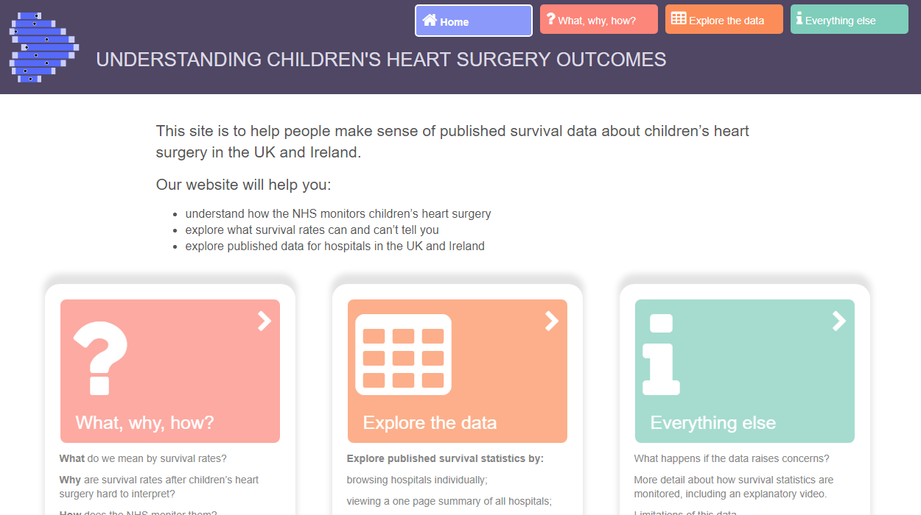
https://childrensheartsurgery.info/data/animation
Notes:
Here’s some work from 2016, where we worked Christina Pagel, a mathematician at UCL, to open up a complicated and sensitive set of statistics. The background of it was that Leeds Infirmary fell out of the expected range for survival for children’s heart surgery. The health authority got spooked and closed the Leeds unit as a result.
First step should be to find out why, to investigate before raising public alarm: 1 in 25 times hospital falls out of expected range by chance. What happened? Some baby data hadn’t been entered into the system correctly – incomplete info. Poor risk communication. Leeds unit was closed as a result of policy professionals misapplying the data.
The aim of this project was to equip not only health policy professionals but journalists and the public with an understanding of children’s heart surgery unit survival data. Our attempt to “democratise” info.
We produced a website and animations that explained the survival data from NHS children’s heart surgery units in the UK and Ireland.
This was an emotive subject that had caused confusion and political headlines, which caused anxiety for parents of sick children.

Slide 16
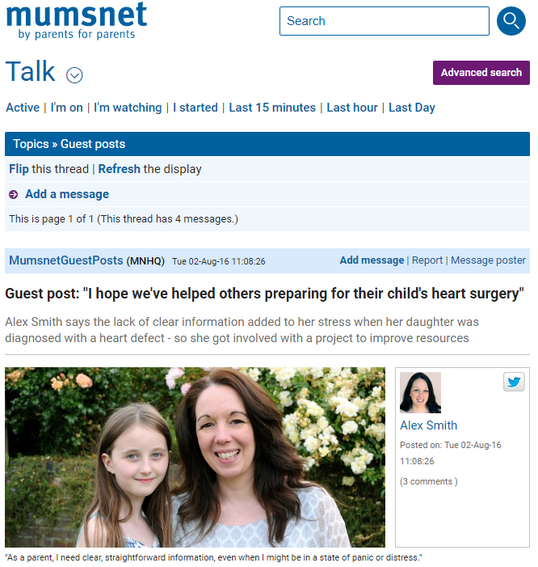
Notes:
We are proud of this resource because now parents, patients, regulators and doctors can see and understand why a hospital’s survival rate needs to be shown in the context of what was predicted for that hospital, considering how severe their cases were. It is a complex proposition, but from the website and animations, parents understood why direct comparisons between units, for instance in league tables, would be crass and misleading. In general, we showed that survival data on their own are completely meaningless (because the best-performing hospital takes on hardest cases). If there’s debate about unit closure, people can now access and understand meaningful data.
This is Alex, one of the parents who helped with user-testing the animation and website, writing about her experience on Mumsnet, launching this parent-led hub.
Since then the website has also been linked to from NHS choices and included as a reference in a letter to Bristol parents following the recent publication of several reports on children’s heart surgery units, which always have the potential to cause anxiety.
What I want you to take away form this no subject is too emotive or controversial or complex to engage people with, if you involve them honestly, where they be parents, policymakers or postmen.

Slide 17
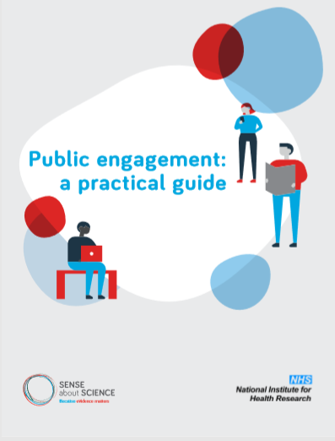
Effective public engagement
http://senseaboutscience.org/activities/public-engagement-guide/
Notes:
Which brings us to our public engagement guide. We’ve spent the last 15 years working at the sharp end of public engagement. Our partnerships are only on issues that make a difference in the public interest and are controversial or sensitive and at risk of going sideways in a serious way. Our approach works to really engage people and following the success of the children’s heart surgery project I just talked about, we worked with NIHR to turn it and the lessons we’ve learned into a practical guide for researchers.
It is targeted to researchers, but they can be applied to and used for talks at local groups, articles, and events.

Slide 18
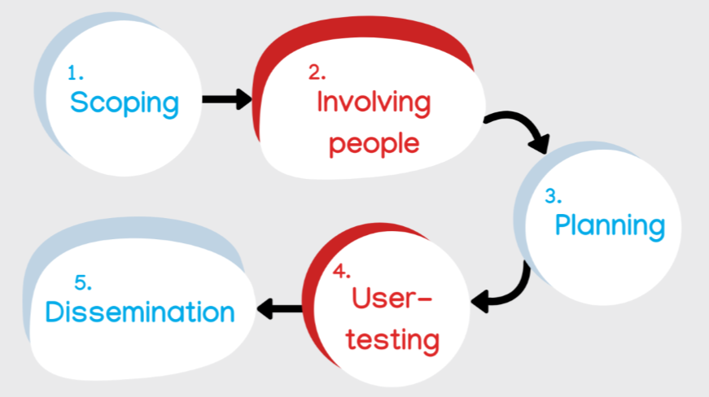
Effective public engagement in 5 steps
Notes:
So this guide talks about the 5 steps of effective public engagement.
5 steps are:
Scoping: Looking at what people are saying about a specific topic
Involving people: Identifying who would be impacted by a specific topic, who has a stake in it, who is talking about this topic and most importantly – who isn’t but should be? Who should be involved but has barriers such as access?
Planning: What is the best way of communicating/disseminating – content and format
User-testing: Developing public engagement material together
Dissemination: Engage with people and use feedback
Take question
Have any audience members go experiences of engaging with policy makers (good or bad!) or having an impact with public engagement that want to share?
Emily start coffee break. 12:00 10 mins.

Slide 19
Activity: Mapping
  Define your audience
  Knowing the right people to involve means you will create a project/resource/policy that is impactful and speaks to people’s needs
Notes:
What kind of policy makers
-break it down more.
5-10 minutes do it in the group first.
What do you already have.
Big map- are they targeted enough. 3 most important.
Wild card

Slide 20
Potential jurors
Legal charities
|
Legal writers
|
Barristers
Crime fiction writers
Making Sense of Forensic Genetics
Journalists
Genealogist
College of Policing
|
Police officers
Voice of Young Science

Slide 21
“Instead of trying to turn politicians into scientists, we should ask: what are the insights and resources from research that would help politicians scrutinise the evidence and the policies, and are they using them?”
– Tracey Brown

Slide 22
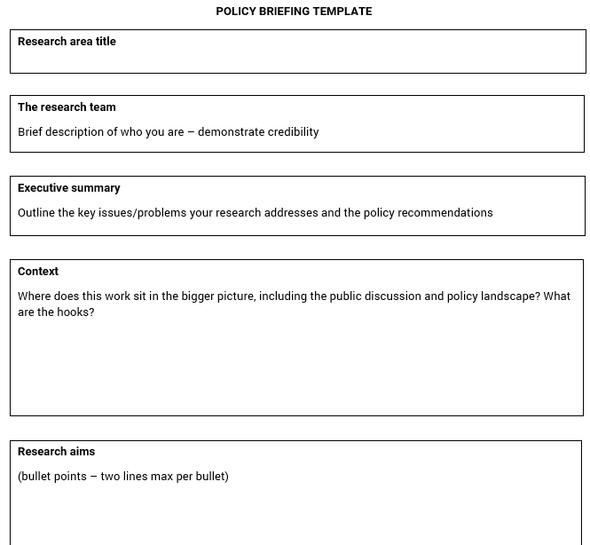
Policy brief cheat sheet
Policymakers are extremely time poor. If you can help take something off their plate instead of adding something new on to it, you are more likely to get a response.
Ask yourself, ‘So what?’ You may have a good piece of research, but you need to provide context about how your work fits into the wider societal picture.
Notes:
You’ll all get a policy briefing template to work on, and Emily and Rebecca will be in touch to coach you through that. For now, we want to introduce you to some practical tips that will help you to effectively communicate evidence to policymakers, and we’re going to use the policy briefing template as a grounding point to do that.
These tips come from years of running our Standing up for Science workshops as part of our Voice of Young Science network. We empower researchers with the confidence and skills to shape the public discourse about science and evidence and to make a policy impact, on issues that really matter to people’s lives. We want you as researchers to see that you don’t live in silos. You have a stake in society, so you should see yourselves as academic citizens.
First, you have to get involved. Policy makers are continually looking for trusted sources of evidence. Make yourself known to those who need evidence by using existing platforms and organisations, networking at events which host different stakeholders, and branching out to work with others in different specialisms. Be reliable and willing to engage and, in time, you will begin to be recommended by others. Your own policy and public affairs team at the University of Exeter is a good place to start, but also look at what your professional society is up to.
Understand that you are experts in your field and you have a valid contribution to make. You may not feel like an expert, but with the zooming out exercise, we hope you’ve seen that know a lot more than most of your audience. More importantly, policymakers don’t expect you to know everything.
Plan your approach. Once you've decided to engage, plan how you are going to do it and what steps you need to take. What do you want to achieve? What issues does a policymaker care about and what are they motivated by? Planning your move will help focus your efforts as well as understand how to balance doing this alongside your normal workload. This is where the policy briefing template can really help you.
Remember that MPs in particular are time-poor (first red box).
Ask yourself ‘So what?’ and provide context (second red box).

Slide 23
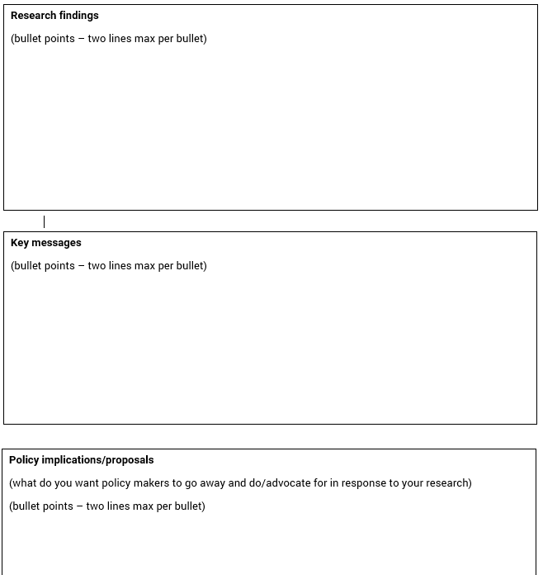
Policy brief cheat sheet
Explain how your research relates to a specific problem they are trying to solve. You can include more information in an appendix, but make sure you get your top 3 key messages right first.
What committees are they on? What did they vote for recently? What have they listed as their interest issues? If you understand this, you’ll be able to tap into the reasons why they might advocate your research and ideas.
Notes:
What are the key messages to get across? Explain in three key bullet points how your research relates to a specific policy problem they’re trying to solve (third red box).
When asking a policymaker to do something or advocate for something, ask yourself why? What do you know about them that would give them a reason to do that? (fourth red box)

Slide 24
If you just remember these, you’ll be fine
Making connections:
Be visible
Find the movers and shakers
Find allies
Use institutional networks
Find your MP
Presenting research:
‘So what?’
Where is your topic in the policy cycle?
Understand the policymaking process
Be brief
Provide context
Notes:
Here we’ve distilled our five top tips for making connections and presenting research to help you get started.
Making connections
Be visible. Be seen online or at events, so that policy makers can find you. Use twitter or write a blog. Make sure your contact details are easy to find.
Find the movers and the shakers. If you want to influence policy, you have to invest in finding out who is taking the policy decisions. Policy engagement is a long-term process, not a one-time activity.
Find your allies. Many NGOs and lobby organizations are well connected and can introduce a new expert. Team up with other research fields, such as economists and behavioural scientists.
Use networks. Find out if your institute has an outreach officer or policy officer, most of them do. Contact the policy officer of your scientific society or professional association.
Find your MP. Someone is representing you in parliament. You are not limited to contacting the MPs who represent your constituency, you can also contact directly MPs who are on committees you’re interested in.
Presenting research
‘So what?’ Put yourself in the mind of a policy maker. Why should a policy maker care? What is the policy problem that your research can help to solve? Don’t tell policy makers what you want, ask them what they need.
Find out where your topic is in the policy cycle. The parliament.uk website is great for seeing what’s already on the table. MPs can ask a parliamentary question on your behalf.
Don’t expect policy makers to understand your research. Try instead to understand the policy making process, so that you can tailor your research for the policy context. It may take some effort, but policy is easier to understand for you than your research is for politicians.
Be brief. Use short key messages, referring to more substantial evidence with links. Or use visuals: a picture can paint a thousand words (and save time and space).
Provide context. Your research will never respond to the entire policy question, so try to understand the bigger picture of the problem that your research is looking at. Be honest about limitations and caveats.

Slide 25
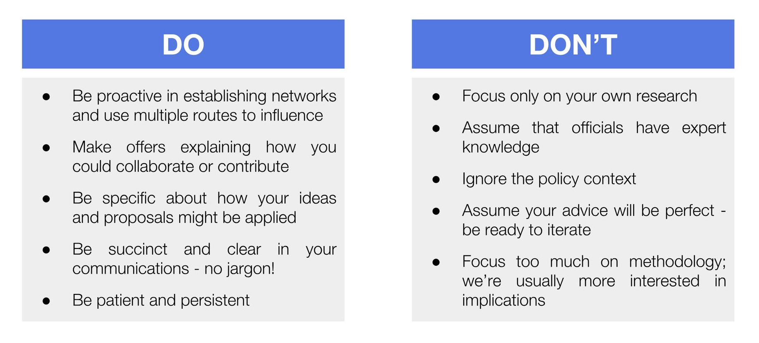
The Open Innovation Team’s top tips to influencing policy-makers:
Notes:
Open Innovation is base at the Cabinet Office and is a new unit dedicated to deepening collaboration between officials and academics

Slide 26
Emily Jesper-Mir: emily@senseaboutscience.org
Ilaina Khairulzaman: ilaina@senseaboutscience.org
Drop us a line if you want us to support your researchers with:
- policy engagement training
- public engagement partnership or training
- capacity building for early career researchers with media, public and policy engagement

Slide 27
  DISCUSSION TIME
Notes:
12.50

